Slide 1
Database Systems
Chapter 21
Concurrency Control Techniques

Slide 2
Introduction
Concurrency control protocols
Set of rules to guarantee serializability
Two-phase locking protocols
Lock data items to prevent concurrent access
Timestamp
Unique identifier for each transaction

Slide 3
Binary locks
Lock
Variable associated with a data item describing status for operations that can be applied
One lock for each item in the database
Binary locks
Two states (values)
Locked (1)
Item cannot be accessed
Unlocked (0)
Item can be accessed when requested

Slide 4
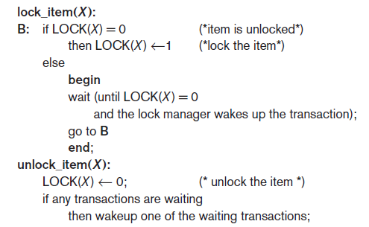
Binary Locks
Transaction requests access by issuing a lock_item(X) operation

Slide 5
Drawbacks of Binary Locks
Binary locks are highly restrictive.
They do not even permit reading of the contents of item X. As a result, they are not used commercially.

Slide 6
Two-Phase Locking Techniques for Concurrency Control (cont’d.)
Lock table specifies items that have locks
Lock manager subsystem
Keeps track of and controls access to locks
Rules enforced by lock manager module
At most one transaction can hold the lock on an item at a given time
Binary locking too restrictive for database items

Slide 7
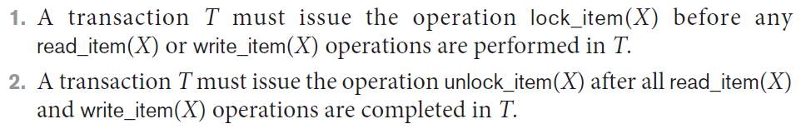
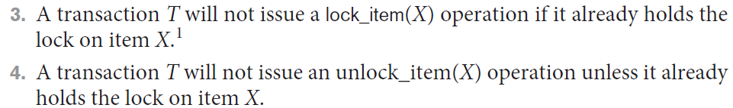
Two-Phase Locking Techniques for Concurrency Control (cont’d.)
If the simple binary locking scheme described is used, then every transaction must obey the following rules:

Slide 8
Two-Phase Locking Techniques for Concurrency Control (cont’d.)
Shared/exclusive or read/write locks or multi-mode locks
Read operations on the same item are not conflicting
Must have exclusive lock to write
Three locking operations
read_lock(X)
write_lock(X)
unlock(X)

Slide 9
Drawbacks of Read and write locks
May not always produce serializable schedule
May not free from irrecoverability
May not free from deadlock and starvation
May not free from Cascade Rollback

Slide 10
Cascading Rollback

Slide 11
Non Serializable Schedules

Slide 12
T1 | T2
write_lock(A)
read_item(A)
Write_item(A)
Unlock(A)
 | write_lock(A)
 | read_item(A)
 | Write_item(A)
write_lock(B) | Unlock(A)
read_item(B)
Write_item(B)
Unlock(B)

Slide 13
T1 | T2
write_lock(A)
read_item(A)
Write_item(A)
Unlock(A)
 | write_lock(A)
 | read_item(A)
 | Write_item(A)
 | Unlock(A)
 | commit
Fail

Slide 14
Cascading Rollback

Slide 15
T1 |  | T2
write_lock(A)
read_item(A)
Write_item(A)
Unlock(A)
 | write_lock(A)
 | read_item(A)
 | Write_item(A)
 | Unlock(A)
 |  | write_lock(A)
Fail |  | read_item(A)
 |  | Write_item(A)
 |  | Unlock(A)

Slide 16
Irrecoverability
T1 | T2
write_lock(A)
read_item(A)
Write_item(A)
Unlock(A)
 | write_lock(A)
 | read_item(A)
 | Write_item(A)
 | Unlock(A)
 | commit
Fail

Slide 17
Deadlock
T1 | T2
read_lock(A)
read_item(A)
 | read_lock(B)
 | read_item(B)
write_lock(B)
write _item (B)
 | write_lock(A)
 | write _item (A)

Slide 18
Starvation
T1 | T2 | T3
 | read_lock(A)
write_lock(A) | read_item(A)
read_item(A) |  | read_lock(A)
Write_item(A) |  | read_item(A) | read_lock(A)
Unlock(A) |  |  | read_item(A) | read_lock(A)
 |  |  |  | read_item(A)

Slide 19
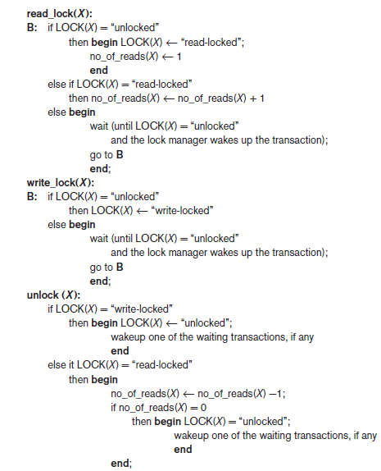
Figure 21.2 Locking and unlocking operations for two-mode (read/write, or shared/exclusive) locks

Slide 20
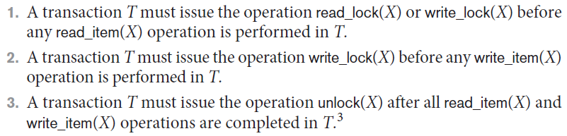
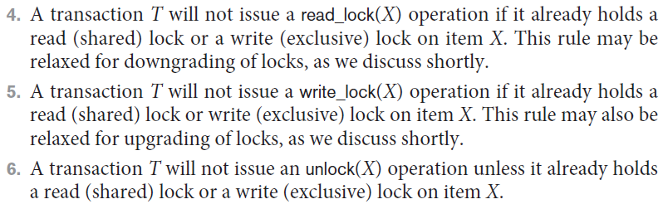
Two-Phase Locking Techniques for Concurrency Control (cont’d.)
When we use the shared/exclusive locking scheme, the system must enforce the following rules:

Slide 21
Two-Phase Locking Techniques for Concurrency Control (cont’d.)
Lock conversion
Transaction that already holds a lock allowed to convert the lock from one state to another
Upgrading
Issue a read_lock operation then a write_lock operation
Downgrading
Issue a read_lock operation after a write_lock operation

Slide 22
Two-Phase Locking Techniques for Concurrency Control (cont’d.)
Using binary read/write locks in transactions, as described earlier, does not guarantee serializability of schedules on its own.
Take an example in the next slide:

Slide 23
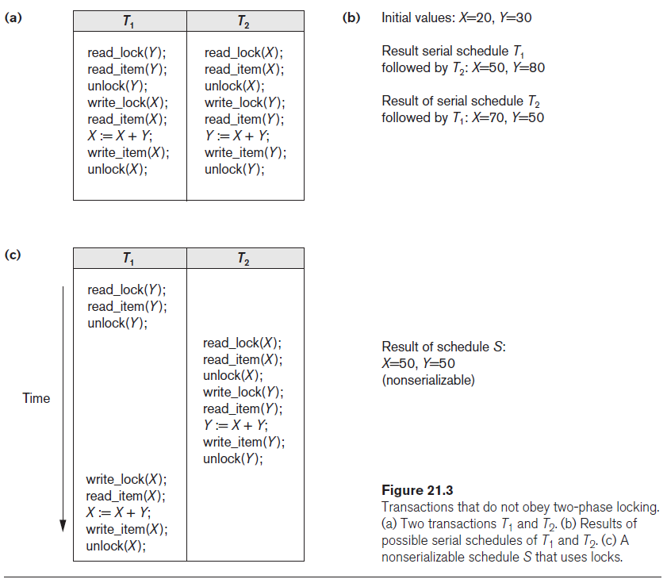

Slide 24
Guaranteeing Serializability by Two-Phase Locking (2PL)
Two-phase locking protocol
All locking operations precede the first unlock operation in the transaction
Phases
Expanding (growing) phase
New locks can be acquired but none can be released
Lock conversion upgrades (from read-locked to write-locked) must be done during this phase
Shrinking phase
Existing locks can be released but none can be acquired
Downgrades (from write-locked to read-locked) must be done during this phase

Slide 25
Guaranteeing Serializability by Two-Phase Locking (2PL)
If every transaction in a schedule follows the two-phase locking protocol, schedule guaranteed to be serializable
Two-phase locking may limit the amount of concurrency that can occur in a schedule
Some serializable schedules will be prohibited by two-phase locking protocol

Slide 26
Drawbacks of 2PL
May not free from irrecoverability
May not free from deadlock
May not free from starvation
May not free from cascading rollback

Slide 27
Upgrade / Downgrade locks :
A transaction that holds a lock on an item A is allowed under certain condition to change the lock state from one state to another.
Upgrade: A S(A) can be upgraded to X(A) if Ti is the only transaction holding the S-lock on element A.
Downgrade: We may downgrade X(A) to S(A) when we feel that we no longer want to write on data-item A. As we were holding X-lock on A, we need not check any conditions.

Slide 28
Variations of Two-Phase Locking (2PL)
Basic 2PL
Technique described on previous slides
Conservative (static) 2PL
Requires a transaction to lock all the items it accesses before the transaction begins
Predeclare read-set and write-set
Deadlock-free protocol
difficult to use in practice because of the need to predeclare the read-set and write-set, which is not possible in some situations.
Strict 2PL
Transaction does not release exclusive locks (write locks) until after it commits or aborts. It is not deadlock-free.
It is always cascadeless and recoverable.

Slide 29
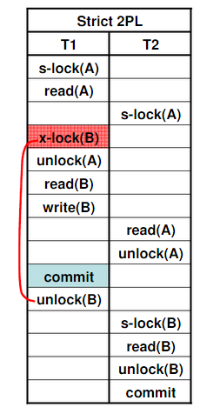
Strict 2PL
Strict-2PL waits until the whole transaction to commit, and then it releases all the locks at a time.
Strict-2PL protocol does not have shrinking phase of lock release.

Slide 30
Variations of Two-Phase Locking (cont’d.)
Rigorous 2PL
Transaction does not release any locks (exclusive or shared) until after it commits or aborts
Concurrency control subsystem responsible for generating read_lock and write_lock requests
Locking generally considered to have high overhead
because every read or write operation is preceded by a system locking request

Slide 31
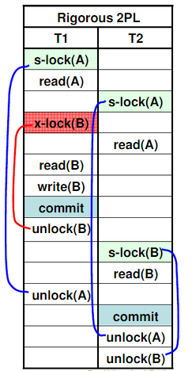

Slide 32
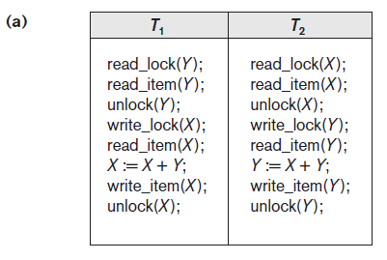

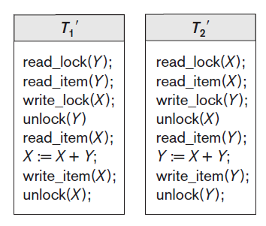
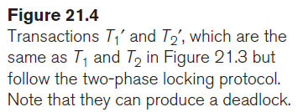

Slide 33
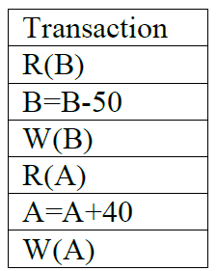
EXAMPLE(Past Paper 2020)
Add lock and unlock instructions to that particular
transaction in such a way that they observe the two-phase
locking protocol.

Slide 34
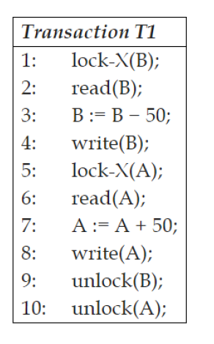
SOLUTION

Slide 35
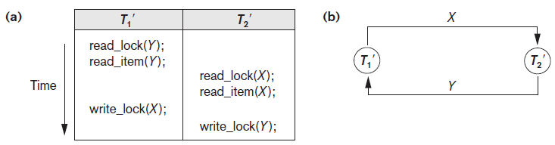
Dealing with Deadlock and Starvation
Deadlock
Occurs when each transaction T in a set is waiting for some item locked by some other transaction T’
Both transactions stuck in a waiting queue
Figure 21.5 Illustrating the deadlock problem (a) A partial schedule of T1′ and T2′ that is
in a state of deadlock (b) A wait-for graph (WFG) for the partial schedule in (a)

Slide 36
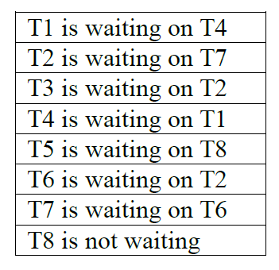
EXAMPLE(Past Paper 2020)

Slide 37
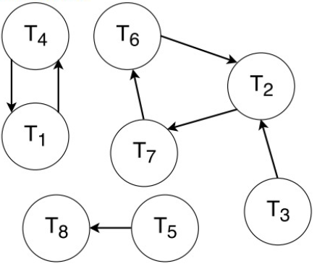
T1, T2, T4, T6, and T7.

Slide 38
Dealing with Deadlock and Starvation (cont’d.)
Deadlock prevention protocols
Every transaction locks all items it needs in advance
Ordering all items in the database
Transaction that needs several items will lock them in that order
Both approaches impractical

Slide 39
Dealing with Deadlock and Starvation (cont’d.)
A number of other deadlock prevention schemes have been proposed that make a decision about what to do with a transaction involved in a possible deadlock situation:
these techniques use the concept of transaction timestamp TS(T′), which is a unique identifier assigned to each transaction.
if transaction T₁ starts before transaction T₂,
then TS(T₁) < TS(T₂).
NOTE: older transaction (which starts first) has the smaller timestamp value

Slide 40
Dealing with Deadlock and Starvation (cont’d.)
2 Protocols based on a timestamp
Suppose that transaction T_{i} tries to lock an item X but is not able to because X is locked by some other transaction T_{j}
Notes:
Wait-Die scheme
In this scheme, if a transaction requests for a resource which is already held with a conflicting lock by another transaction then the DBMS simply checks the timestamp of both transactions. It allows the older transaction to wait until the resource is available for execution.
Let's assume there are two transactions Ti and Tj and let TS(T) is a timestamp of any transaction T. If T2 holds a lock by some other transaction and T1 is requesting for resources held by T2 then the following actions are performed by DBMS:
Check if TS(Ti) < TS(Tj) - If Ti is the older transaction and Tj has held some resource, then Ti is allowed to wait until the data-item is available for execution. That means if the older transaction is waiting for a resource which is locked by the younger transaction, then the older transaction is allowed to wait for resource until it is available.
Check if TS(Ti) < TS(Tj) - If Ti is older transaction and has held some resource and if Tj is waiting for it, then Tj is killed and restarted later with the random delay but with the same timestamp.
Wound wait scheme
In wound wait scheme, if the older transaction requests for a resource which is held by the younger transaction, then older transaction forces younger one to kill the transaction and release the resource. After the minute delay, the younger transaction is restarted but with the same timestamp.
If the older transaction has held a resource which is requested by the Younger transaction, then the younger transaction is asked to wait until older releases it.

Slide 41
_{Wait-Die scheme}
In this scheme, if a transaction requests for a resource which is already held with a conflicting lock by another transaction then the DBMS simply checks the timestamp of both transactions. It allows the older transaction to wait until the resource is available for execution.
Let's assume there are two transactions Ti and Tj and let TS(T) is a timestamp of any transaction T. If T2 holds a lock by some other transaction and T1 is requesting for resources held by T2 then the following actions are performed by DBMS:
Check if TS(Ti) < TS(Tj) - If Ti is the older transaction and Tj has held some resource, then Ti is allowed to wait until the data-item is available for execution. That means if the older transaction is waiting for a resource which is locked by the younger transaction, then the older transaction is allowed to wait for resource until it is available.
Check if TS(Ti) < TS(Tj) - If Ti is older transaction and has held some resource and if Tj is waiting for it, then Tj is killed and restarted later with the random delay but with the same timestamp.

Slide 42
Wound wait scheme
In wound wait scheme, if the older transaction requests for a resource which is held by the younger transaction, then older transaction forces younger one to kill the transaction and release the resource. After the minute delay, the younger transaction is restarted but with the same timestamp.
If the older transaction has held a resource which is requested by the Younger transaction, then the younger transaction is asked to wait until older releases it.

Slide 43
Other Methods for Deadlock Prevention

Slide 44
Wait – Die | Wound -Wait
It is based on a non-preemptive technique. | It is based on a preemptive technique.
In this, older transactions must wait for the younger one to release its data items. | In this, older transactions never wait for younger transactions.
The number of aborts and rollback is higher in these techniques. | In this, the number of aborts and rollback is lesser.

Slide 45
No Waiting (NW)
Another group of protocols that prevent deadlock do not require timestamps.
These include the no waiting (NW) and cautious waiting (CW) algorithms.
In the no waiting algorithm, if a transaction is unable to obtain a lock, it is immediately aborted and then restarted after a certain time delay without checking whether a deadlock will actually occur or not.
In this case, no transaction ever waits, so no deadlock will occur.
However, this scheme can cause transactions to abort and restart needlessly.

Slide 46
Cautious Waiting
The cautious waiting algorithm was proposed to try to reduce the number of needless aborts/restarts.
Suppose that transaction Ti tries to lock an item X but is not able to do so because X is locked by some other transaction Tj with a conflicting lock. The cautious waiting rule is as follows:
■ Cautious waiting. If Tj is not blocked (not waiting for some other locked item), then Ti is blocked and allowed to wait; otherwise abort Ti.

Slide 47
Dealing with Deadlock and Starvation (cont’d.)
No waiting algorithm
If transaction unable to obtain a lock, immediately aborted and restarted later
Deadlock detection
System checks to see if a state of deadlock exists
Wait-for graph (a state of deadlock if and only if the wait-for graph has a cycle)

Slide 48
Dealing with Deadlock and Starvation (cont’d.)
Victim selection
Deciding which transaction to abort in case of deadlock (avoid selecting transactions that have been running for a long time)
Timeouts
If system waits longer than a predefined time, it aborts the transaction
Starvation
Occurs if a transaction cannot proceed for an indefinite period of time while other transactions continue normally
Solution: first-come-first-served queue

Slide 49
Concurrency Control Based on Timestamp Ordering
Timestamp
Unique identifier assigned by the DBMS to identify a transaction
Assigned in the order submitted
Transaction start time
Concurrency control techniques based on timestamps do not use locks, so
Deadlocks cannot occur

Slide 50
Concurrency Control Based on Timestamp Ordering (cont’d.)
Generating timestamps
Counter incremented each time its value is assigned to a transaction
Current date/time value of the system clock
Ensure no two timestamps are generated during the same tick of the clock
General approach
Enforce equivalent serial order on the transactions based on their timestamps

Slide 51
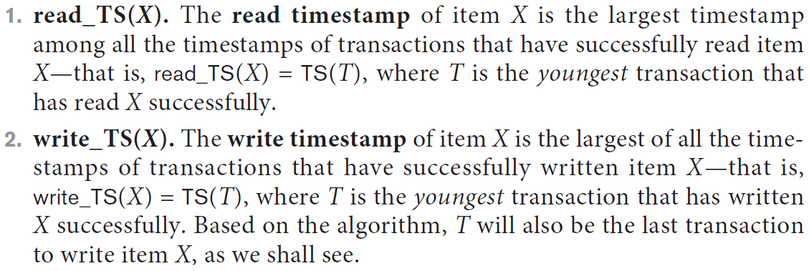
Concurrency Control Based on Timestamp Ordering (cont’d.)
Timestamp ordering (TO)
Allows interleaving of transaction operations
Must ensure timestamp order is followed for each pair of conflicting operations
Each database item assigned two timestamp values 1) read_TS(X) and 2) write_TS(X)

Slide 52
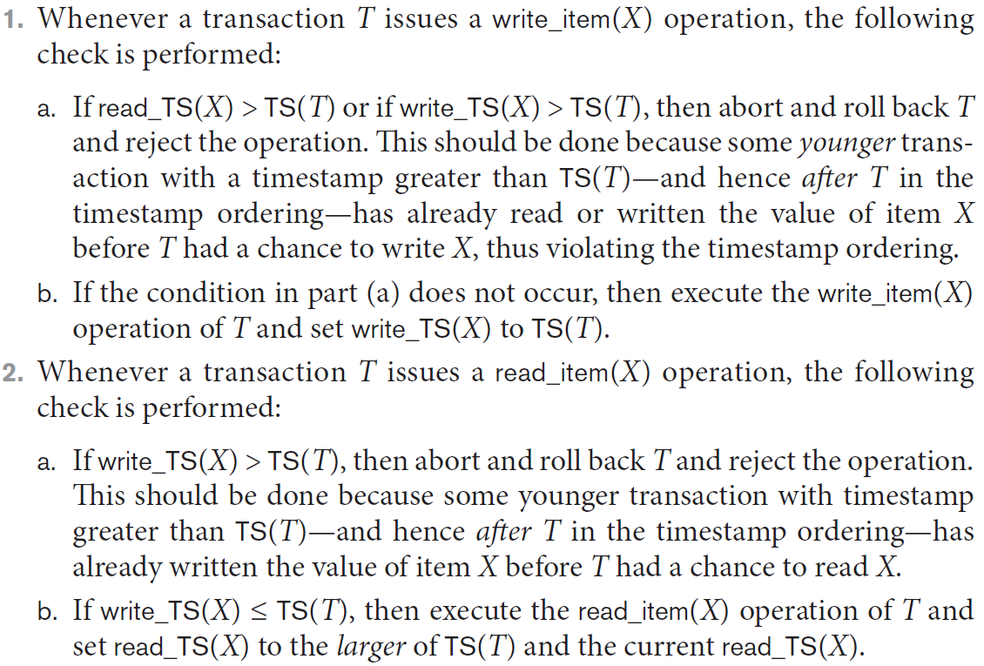
Concurrency Control Based on Timestamp Ordering (cont’d.)
Basic TO algorithm
Starvation may occur
Notes:
R1(A);R2(B);W1(C);R3(B);R1(C);W2(B);W3(A)

Slide 53
RULES
Transaction Ti issues a Read(item) operation.
if WTS(item)>Ts(Ti) then Rollback Ti
Else excecute R(A) operation.
Set RTS(item)=Max(RTS(item), Ts(Ti))
Transaction Ti issues Write(item) operation
If RTS(item)>Ts(Ti) then Rollback Ti
If WTS(item)>Ts(Ti) then Rollback Ti
ELSE execute write operation
SET WTS(Item)=Ts(Ti)

Slide 54
EXAMPLE
T1(100) | T2(200) | T3(300)
R(A)
 | R(B)
W(C)
 |  | R(B)
R(C)
 | W(B)
 |  | W(A)
 | A | B | C
RTS(Ti) | 0 | 0 | 0
WTS(Ti) | 0 | 0 | 0
 | A | B | C
RTS(Ti) | 0 100 | 0 200 300 | 0 100
WTS(Ti) | 0 300 | 0 | 0 100
WHICH TRANSACTION WILL BE ROLLED BACK? T2
Notes:
WHICH TRANSACTION WILL BE ROLLED BACK?

Slide 55
Concurrency Control Based on Timestamp Ordering (cont’d.)
Strict TO algorithm
Ensures schedules are both strict and conflict serializable

Slide 56
Concurrency Control Based on Timestamp Ordering (cont’d.)
Thomas’s write rule
Modification of basic TO algorithm
Does not enforce conflict serializability
Rejects fewer write operations by modifying checks for write_item(X) operation

Slide 57
Thomas write rule
If TS(T) < R_TS(X) then transaction T is aborted and rolled back, and operation is rejected.
If TS(T) < W_TS(X) then don't execute the W_item(X) operation of the transaction and continue processing.
If neither condition 1 nor condition 2 occurs, then allowed to execute the WRITE operation by transaction Ti and set W_TS(X) to TS(T).

Slide 58
